Slide 1






PRESENTATION 2026
[Automating digital campaigns with Excel and chatbots]
Mentor Name
Student Name
Student Email
Umamaheswari
N V Akshitha
ammuyadav1600@gmail.com

Slide 2

Outline
Abstract of the Project
Problem Statement
Proposed Solution
System Architecture
Live Demo of the Project
Embedded Video of Project
Conclusion
Future Scope

Slide 3

Abstract
This project focuses on automating digital marketing campaigns using Microsoft Excel and AI chatbots. In today’s fast-paced marketing environment, creating content manually for different platforms is time-consuming and inefficient.
The project uses a structured dataset containing details such as product name, industry, target audience, marketing platform, and keywords. The data is cleaned and analyzed using Excel to ensure accuracy and consistency.
Based on this dataset, AI chatbots are used to generate marketing content such as captions, advertisements, and promotional messages through prompt engineering.
Additionally, dashboards and visualizations are created to identify trends in industries, platforms, and campaign goals.
Overall, this project demonstrates how the integration of data analytics and AI tools can improve marketing efficiency, reduce manual effort, and support better decision-making.

Slide 4

Problem Statement
In today’s digital marketing environment, businesses need to create large amounts of content for different platforms such as social media, email campaigns, and advertisements.
However, creating marketing content manually is time-consuming, repetitive, and often leads to inconsistencies.
Even though structured marketing data is available, it is difficult to quickly convert this data into effective and engaging marketing content.
Additionally, there is a lack of integration between data analysis tools and AI-based content generation systems, which reduces efficiency and slows down decision-making.

Slide 5

Proposed Solution
To address the challenges of manual marketing content creation and inefficient data usage, this project proposes an AI-assisted marketing analysis system using Microsoft Excel and AI chatbots.
The solution involves collecting a structured marketing dataset and performing data cleaning using Excel to ensure accuracy and consistency.
After preprocessing, the data is analyzed using pivot tables and charts to identify key trends such as industry distribution, platform usage, and campaign goals.
AI chatbots are then integrated using prompt engineering techniques to automatically generate marketing content such as captions, advertisements, and promotional messages based on the dataset.
Additionally, dashboards and visualizations are created to present insights in a clear and user-friendly manner, enabling faster and better decision-making.

Slide 6
System Architecture
Data Input / Source
Processing / Analysis
Marketing Dataset (CSV/Excel)
Contains multiple rows and columns related to campaigns
Fields include:
Product / Service Name ,Industry
Target Audience ,Marketing Platform Content Type ,Campaign Goal
Data cleaning using Microsoft Excel
Removed duplicates and handled missing values
Data analysis using:
Pivot tables
Charts for industry & platform analysis
Keyword and campaign trend analysis
AI / Tool Integration
[ Excel ,Copilot , or AI Chatbots are integrated.]

Slide 7
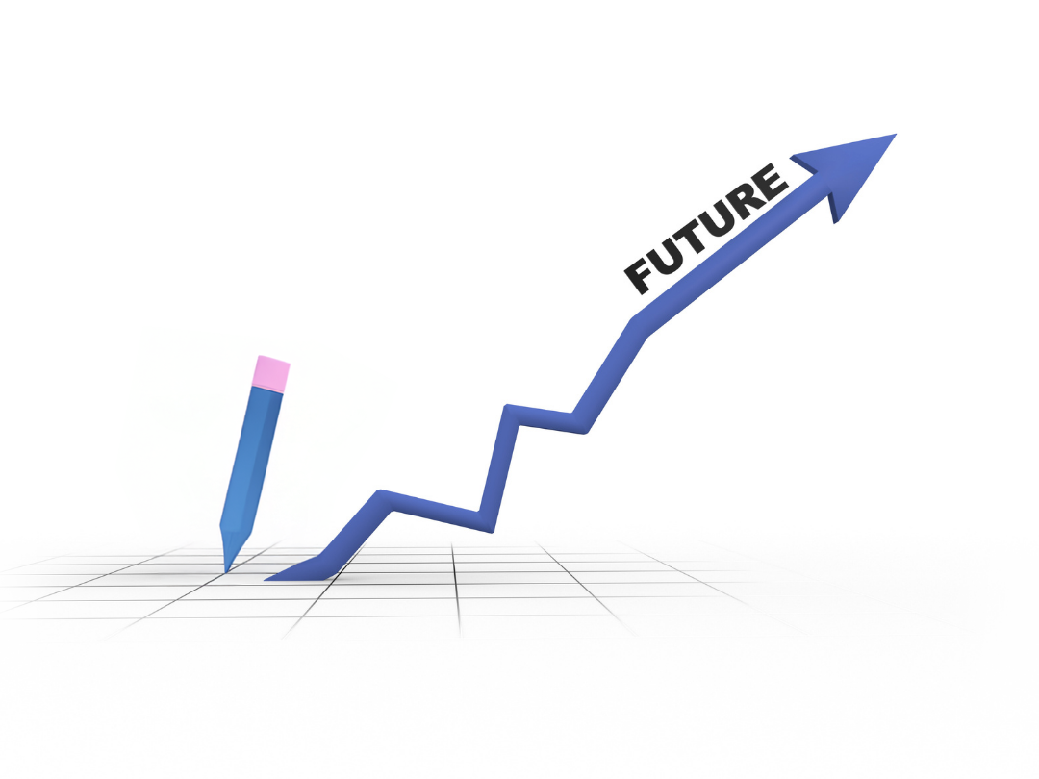
Future Scope
Integrate more advanced AI models to generate highly personalized and creative marketing content.
Real-time Data Integration
Connect the system with live data sources (social media, websites, CRM tools) for real-time campaign updates.
Multi-language Content Generation
Enable chatbots to create marketing content in multiple languages to target global audiences.
Automation with APIs
Integrate APIs of platforms like Instagram, Facebook, and email tools to directly publish campaigns automatically.
Predictive Analytics
Use machine learning to predict campaign performance, customer behavior, and trending marketing strategies.
Enhanced Dashboard Visualization
Develop interactive dashboards with advanced tools like Power BI or Tableau for better insights.
Voice-based Chatbot Integration

Slide 8

Conclusion
This project successfully demonstrates how marketing data can be cleaned, analyzed, and transformed into meaningful insights using Microsoft Excel and AI chatbot tools.
The integration of AI enables automatic generation of marketing content such as captions, advertisements, and promotional messages, reducing manual effort and saving time.
The use of dashboards and visualizations helps in understanding marketing trends and supports better decision-making.
Overall, the project highlights the effectiveness of combining data analytics with AI to improve productivity, efficiency, and marketing strategy development.
CONCLUSION

Slide 9
Thank You
AICW Fellowship | Student Project Presentation 2026
LinkedIn | Edunet Foundation

